Slide 1
Visualizing the Constraint Satisfaction Problem Space
Anton Ridgway

Slide 2
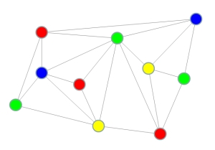
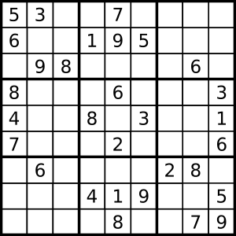
Introduction
From http://web.engr.illinois.edu/~slazebni/fall13/assignment2.html
From http://www.udg.edu/udgglobal/News/Morenews/tabid/20138/Default.aspx?p=32857

Slide 3
Introduction
Constraint satisfaction problems:
A set of variables, V, which can each take on a value from a domain D.
A set of constraints, C, which constrain which domain values are acceptable for specific variables.
Unary constraints disallow a variable’s value always.
Binary constraints disallow values dependent on the values of other variables.
We want to find a set of values for V which satisfies C.
In distributed settings, an agent is assigned to each variable and interacts with others to solve the problem.

Slide 4
Problem to Address
How can we visualize a CSP problem space?
Most interesting for researchers in the CSP space
Useful for characterizing problem spaces for specific applications
Visual information conveyed better than numbers only
Multiple snapshots over time can help to understand algorithm behaviors
New perspectives can inspire new developments
Useful for simple debugging–it is easier to detect logical errors by visual inspection than by poring over log files and debug information

Slide 5
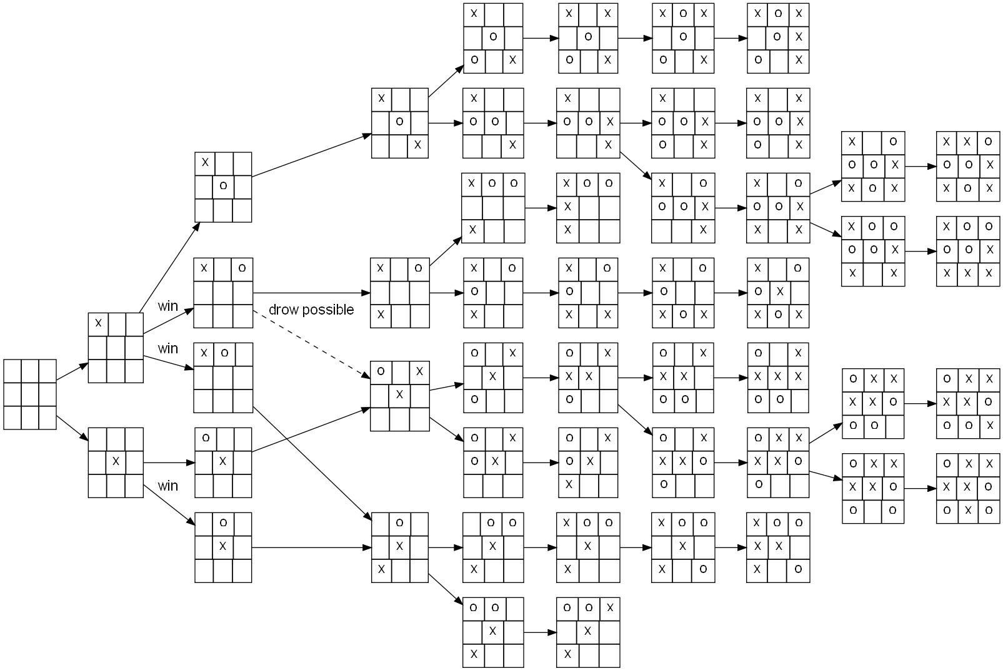
Solution Approaches
From http://commons.wikimedia.org/wiki/File:Tic-tac-toe-full-game-tree-x-rational.jpg

Slide 6
Solution Approaches
Typically, problem spaces are represented as full, complete, n-ary trees
Problems spaces tend to be both uniform (because they are combinatorial) and dense (because of the exponential state expansion).
Radial trees can aid in visibility, since it makes the most of lateral space as the number of options expands
A mesh approach could also be useful
One vertex per node, plus connecting nodes
We don’t generally care about particular values
Disc shape most natural
Height more visually obvious than color
Better fits “landscape” metaphor, with maxima and minima

Slide 7
Solution Approaches
Animation is important if we want to see how the algorithm is behaving over time.
Constraints remove choices
Could be represented explicitly by removing branches, or implicitly since they will remain at a value of zero in any visualization.

Slide 8
Solution Approaches
Leaf-node only visualization
Histograms, area maps
Graph-based tree visualization
Hierarchical trees, dendrograms
Radial trees, 3D cone trees
Mesh visualization
Circular meshes

Slide 9
Data to Visualize
Data derived from CSP tests with various algorithms in FarmX simulator
Algorithms:
Distributed Stochastic Algorithm (DSA)
Distributed Breakout Algorithm (DBA)
Asynchronous Partial Overlay (APO)
Asynchronous Forward-checking Conflict-directed Back-jumping (AFC-CBJ)
8 variables, and 3 domain values → 6,561 total configurations → 9,841 total tree nodes
6 variables → 729 configurations, 1,093 nodes

Slide 10
Data Processing Method
To generate initial data, some processing is required
Define a tree as expressed above, and store the discovered value of each configuration in the leaf nodes.
Define parent nodes’ values as the average value of all children’s values
Poll this tree to generate a list of leaf nodes with values, as well as nodes and edges
Process the tree to generate a 3D mesh based on a radial structure

Slide 11
3D Mesh Generation Strategy
Vertex positions are given by transformation from polar coordinates.
Radius is determined by depth in the tree.
Angle is determined by the number of nodes on that level, which is calculated combinatorically.
Vertex normals are produced at the end, by summing the face normals for all faces which include the vertex.

Slide 12
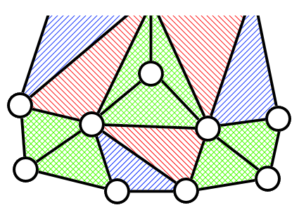
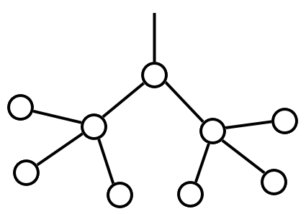
3D Mesh Generation Strategy
Face indices are given by processing vertex indices.
Some extra faces are added to connect branches.

Slide 13
VTK Functionality
Graph visualization
vtkGraphLayout, vtkTableToGraph
Mesh visualization
OBJ format → vtkOBJReader
Animation framework
vtkAnimationCue, vtkAnimationScene
VTK supports most needed functionality, but scalar histogram-style visualizations are not well-supported.

Slide 14
Leaf-node Only
Histograms, area maps
Somewhat helpful, but limited by algorithms’ limited exploration of the problem space

Slide 15
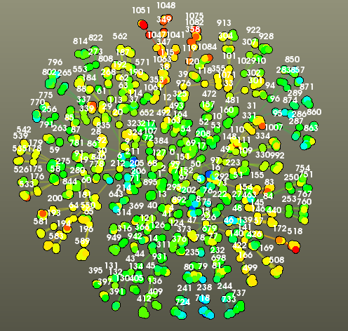
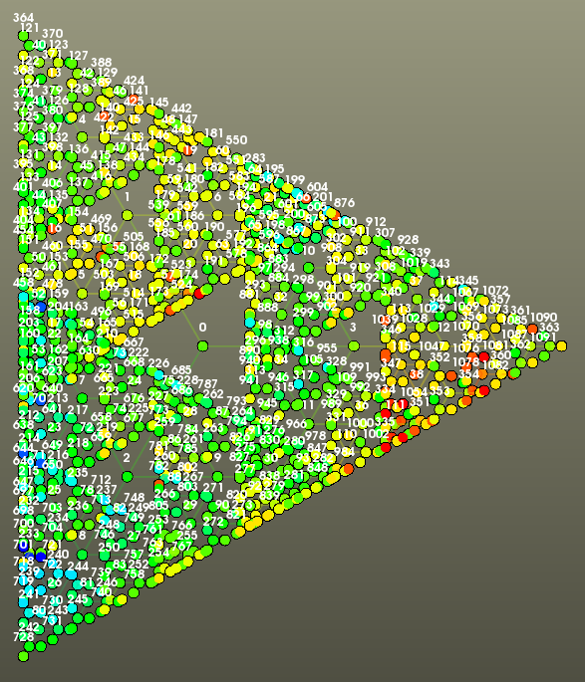
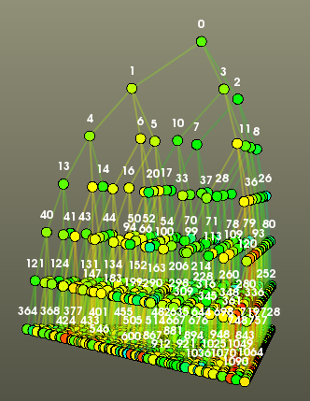
Graphing Approach
Simple graphs, spanning trees, 3D cone trees

Slide 16
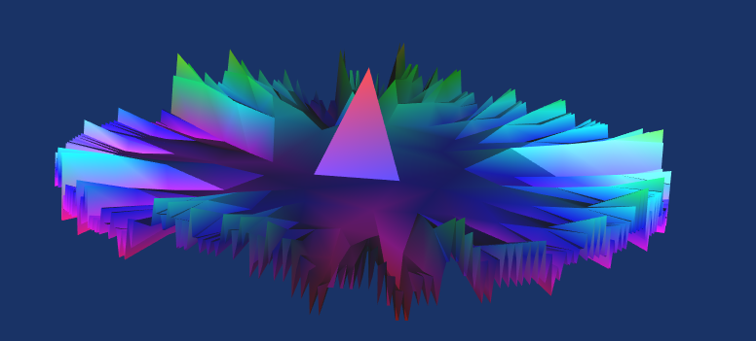
Mesh Approach
Demos

